Slide 1

Neural Networks for Imbalanced and Small Database Classification
Jun Shao
Department of Computer Science and Software Engineering
Oct. 2020

Slide 2
Contents
Introduction.
Methodology.
Network Architecture.
Experiments and Results .
Conclusion

Slide 3
Introduction │Imbalanced learning problem on small database
Imbalanced learning problem is common in industry caused by the difficulty of collecting abundant interesting samples. Imbalanced database usually consists of one or more classes with a large number of instances while the remaining classes with very limited samples.
Challenging:
(1) the pattern of the minority class is hard to learn caused by the small size and minority samples may be treated as noise by the learning model.
(2) the global performance metrics usually induces a bias towards the majority classes.
Another problem associated with small database is overfitting, especially for Deep Neural Networks. As the capability of the network increases, the model probably memorize the limited samples during training, which damages the generalization of the model.

Slide 4
Methodology │Resampling and Cost-sensitive Loss
In the last decade, numerous algorithms have been proposed to solve the imbalance data learning problem. Basically, they are categorized into two classes: Resampling and Cost-sensitive loss.
Resampling:
Over sampling the minority class: Randomly duplicating; Synthetic Minority Over-sampling Technique (SMOTE); Adaptive Synthetic Sampling (ADASYN).
Under sampling the majority class: Random Under Sampling;
Cost-sensitive loss: The cost for the misclassification of a minority class sample should be higher than the loss for majority samples.
Assign different weights to the loss values corresponding to different classes.
The weights for Cross-Entropy Loss function is [0.94, 0.12, 0.94].
Notes:
SMOTE first selects a minority class instance A at random and finds its k nearest minority class neighbors. The synthetic instance is then created by choosing one of
the k nearest neighbors B at random and connecting A and B to form a line segment in the feature space. The synthetic instances are generated as a convex combination of the two chosen instances A and B.
ADASYN is based on the idea of adaptively generating minority data samples according to their distributions: more synthetic data is generated for minority
class samples that are harder to learn compared to those minority samples that are easier to learn [

Slide 5
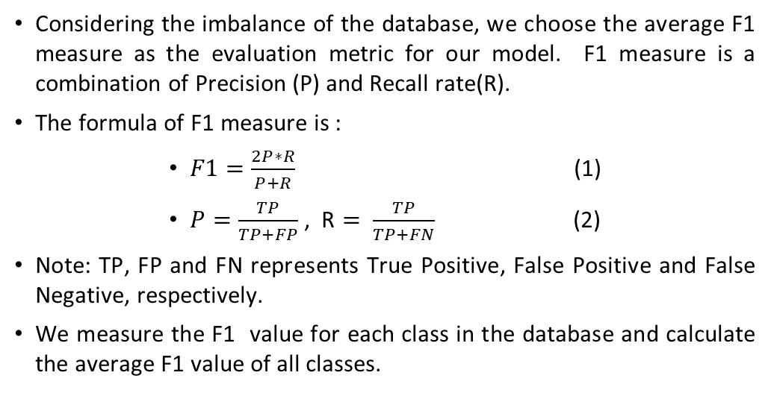
Methodology │Evaluation metrics
Considering the imbalance of the database, we choose the average F1 measure as the evaluation metric for our model. F1 measure is a combination of Precision (P) and Recall rate(R).
The formula of F1 measure is :
$F1=\frac{2P∗R}{P+R}$ (1)
$P=\frac{TP}{TP+FP}$ , R $= \frac{TP}{TP+FN}$ (2)
Note: TP, FP and FN represents True Positive, False Positive and False Negative, respectively.
We measure the F1 value for each class in the database and calculate the average F1 value of all classes.

Slide 6
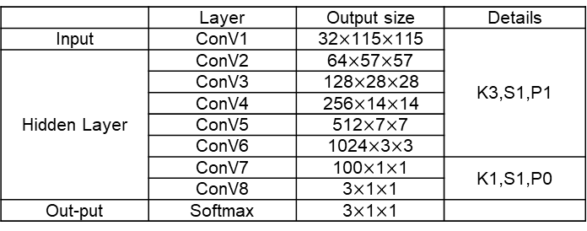
Network Architecture │Fully Convolutional Network
We build a Fully Convolutional Network (FCN) as the basic model for our imbalanced data classification.
FCN consists only of locally connected layers, such as Convolutional layer, Batch Normalization and pooling. The architecture of the FCN:
Table 1. Fully Convolutional Network Architecture
(’K’, ’S’ and ’P’ denotes ‘Kernel_size’, ‘Stride’ and ‘Padding’).
 | Layer | Output size | Details
Input | ConV1 | 32$×$115$×$115 | K3,S1,P1
Hidden Layer | ConV2 | 64$×$57$×$57
 | ConV3 | 128$×$28$×$28
 | ConV4 | 256$×$14$×$14
 | ConV5 | 512$×$7$×$7
 | ConV6 | 1024$×$3$×$3
 | ConV7 | 100$×$1$×$1 | K1,S1,P0
 | ConV8 | 3$×$1$×$1
Out-put | Softmax | 3$×$1$×$1
Note: From Conv1 to ConV6, convolutions are followed by BatchNorm, ReLU and MaxPool(2).

Slide 7
Network Architecture │Transfer-learning with pretrained ResNet
Well pre-trained Deep Neural Network on big database can be used for feature extraction, which is known as transfer-learning.
In this work, we utilize the pre-trained ResNet-18 to extract features for our Network. ResNet-18 was well trained on ImageNet. We fix the parameters of the convolutional layers of ResNet-18 and throw away the last non-convolutional layers.
After feature extraction, the outcome with a size of (512,4,4), was fed into a four-layer FCN followed by a Softmax layer.
Table 2: The architecture of FCN in transfer-learning.
 | Layer | Output size | Details
Input | ConV1 | 800*2*2 | K3,S1,P1
Hidden Layer | ConV2 | 1024*1*1
 | ConV3 | 100*1*1 | K1, S1,P0
 | ConV4 | 3*1*1
Output | Softmax | 3,
Note: The first two convolutions are followed by BatchNorm, ReLU and MaxPool(2).
Notes:
The first two convolutions of the FCN with the parameters: K=3, S=1 and P=1, are followed by BatchNorm, MaxPool(2) and ReLU. The parameters of last two convolutions are: K=1, S=1 and P=0.

Slide 8
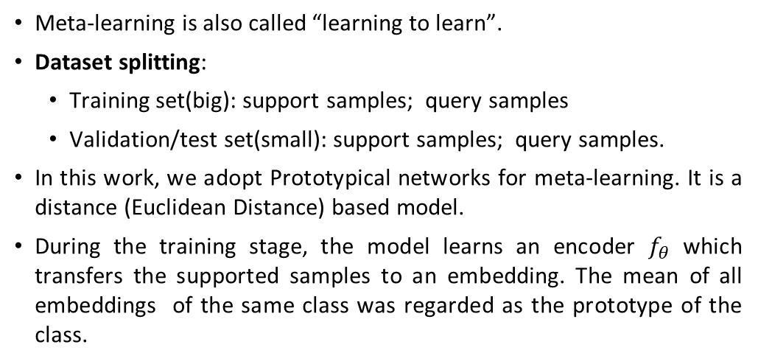
Network Architecture │Meta-learning
Meta-learning is also called “learning to learn”.
Dataset splitting:
Training set(big): support samples; query samples
Validation/test set(small): support samples; query samples.
In this work, we adopt Prototypical networks for meta-learning. It is a distance (Euclidean Distance) based model.
During the training stage, the model learns an encoder $f_{θ}$ which transfers the supported samples to an embedding. The mean of all embeddings of the same class was regarded as the prototype of the class.
Table 3: The architecture of the encoder in Prototypical Network.
 | Layer | Output size | Details
Input | ConV1 | 64*14*14 | K3,S1,P1
Hidden Layer | ConV2 | 64*7*7
 | ConV3 | 64*3*3
 | ConV4 | 64*1*1
Output | Flatten | 64,
Note: all convolutions are followed by BatchNorm, ReLU and MaxPool(2).
Notes:
The method requires a classifier to generalize the learning in one task to a new task, in which new classes are not seen during the training process.

Slide 9
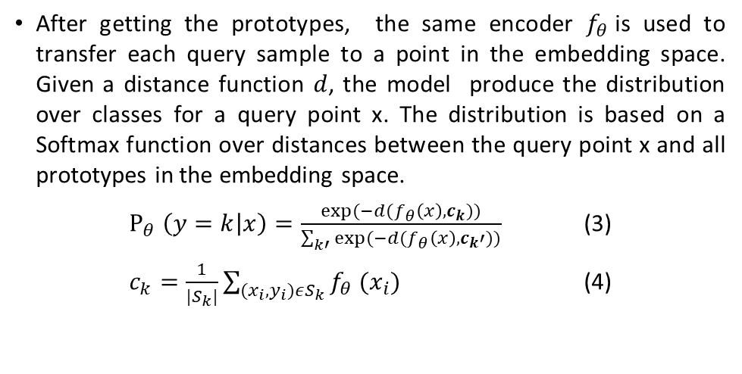
Network Architecture │Meta-learning
Fig. 1. Prototypical networks for few-shot learning. Few-shot prototypes ck are computed as the mean of embedded support examples for each class. Then embedding query points are classified via softmax over distances to class prototypes.
The figure is from (Snell et al., 2010).
After getting the prototypes, the same encoder $f_{θ}$is used to transfer each query sample to a point in the embedding space. Given a distance function $d$, the model produce the distribution over classes for a query point x. The distribution is based on a Softmax function over distances between the query point x and all prototypes in the embedding space.
$Ρ_{θ} \left(y=k | x\right)=\frac{exp⁡(−d(f_{θ}\left(x\right),c_{k}))}{\sum_{k′}{exp⁡(−d(f_{θ}\left(x\right),c_{k}′))}}$ (3)
$c_{k}=\frac{1}{|S_{k}|}\sum_{(x_{i},y_{i})εS_{k}}{f_{θ} (x_{i})}$ (4)

Slide 10
Experiments and Results │ Database for FCNs
Table 4: The structure of the plywood knots database.
Classes | Large Knots | NoDefect | Small Knots | total
Train | 56 | 917 | 63 | 1036
Val | 8 | 131 | 8 | 147
Test | 16 | 262 | 16 | 294
All set | 80 | 1310 | 87 | 1477
The wood knots database consists of three classes: Large Knots:80, No Defect: 1310 and Small Knots:87. Large and Small Knots are minority classes.
We randomly split all classes of the database by 7:1:2, then get the training, validation and test set also with a proportion of 7:1:2.
Large Knot
No Defect
Small Knot
Notes:
It is worth noting that the proportion for splitting is related to the final test performance due to the limited number of interesting samples.

Slide 11
Experiments and Results │ Database for Meta-learning
For the meta-learning experiment, we randomly choose 100 classes from the ImageNet ILSVRC dataset as the training set.
We combine the training and validation set of wood knots database as a new validation set to choose the best model of prototypical networks during the learning on ImageNet.
Finally, we test the model on the test set of the wood knots database.
Notes:
During each episode of training on ImageNet ILSVRC, the model randomly choose 60 classes from the training set and 5 images from each classes to calculate the prototypes (embedding with size of 64). Then the model produces the embeddings of 5 query images from each class and calculate their class distributions based on a Softmax function over embedding distances. The loss will be used to update the parameters of the encoder, so that the query samples can obtain a better classification accuracy.
During the validation or test period, all three classes are chosen from the dataset, and 5 images are randomly chosen for prototypes and 15/11 query samples are used to calculate the accuracy of classification. There are 100 episodes for both validation and test.

Slide 12
Experiments and Results │ FCNs and Transfer-learning
Fig.2. Training process of basic FCN, FCN+cost-sensitive loss and ResNet+ADASYN model.
Fig.3. Training process of FCN+SMOTE and FCN+ADASYN model.
Due to the small size of validation set, the validation loss, F1 value and accuracy vibrate obviously. While indicators of training change smoothly because of the relatively bigger size of training set.
Although the database used for training is small, we did not observe obvious over-fitting, because there is no drop of validation F1 value during the later stage of training.

Slide 13
Experiments and Results │ FCNs and Transfer-learning
Table 5: The Comparison of model performance among FCNs and ResNet+FCN (C1,C2,C3 are three classes).
Model | Test F1 |  |  |  | Test Accuracy | Test time(s)
 | Average | C1 | C2 | C3
Basic FCN | 0.921 | 0.867 | 0.994 | 0.903 | 0.983 | 3.00
FCN+ cost sensitive | 0.958 | 0.968 | 0.996 | 0.909 | 0.990 | 3.14
FCN+ SMOTE | 0.968 | 0.968 | 0.998 | 0.938 | 0.993 | 3.05
FCN+ ADASYN | 0.978 | 1.000 | 0.997 | 0.938 | 0.993 | 3.26
Res+FCN+ ADASYN | 0.933 | 0.875 | 0.992 | 0.933 | 0.983 | 11.82
As shown in Table 5, FCN models with oversampling methods achieve the two highest average F1 value in test set, which shows the superiority of oversampling method for alleviating the impacts of imbalanced data distribution.
FCN combined with cost-sensitive loss outperforms the basic FCN without any methods for data imbalance, but is prior to the oversampling methods. Compared with FCN+ADASYN, ResNet+FCN model with ADASYN does not show its superiority on small database.
Compared with transfer-learning method, the FCN based models achieve a faster test speed 3.00-3.26 seconds (90~98 frames/sec) than ResNet+FCN model 11.82 seconds (25 frames/sec).

Slide 14
Experiments and Results │ FCNs and Transfer-learning
Fig.4. The training process of meta-learning.
As shown above, there is no obvious over-fitting during the training process.
We test the learned model on wood knots database, obtaining a test accuracy of 0.786. The relatively lower performance of Prototypical networks may be caused by the random classes we selected from the ImageNet ILSVRC dataset. In the ImageNet, it is hard to select some classes that are similar with wood knots classes.
The algorithms chosen for meta-learning also impact the performance.

Slide 15
Conclusion
In this work, we build a Fully Convolutional Network (FCN) for wood knots classification.
Considering the small size and the imbalanced data distribution, we tested and compared the methods of re-sampling, cost-sensitive loss, feature extraction by a pre-trained ResNet model and meta-learning system on the small and imbalanced database.
Extensive experiments show that over-sampling(ADASYN) + Random Under sampling method achieves the best performance than other methods.
Although meta-learning achieves a lower performance than other FCN based networks in this work, meta-learning is a promising methods for few-shot learning and even zero-shot learning. When the number of classes increases, the performance of FCN may decrease rapidly, while meat-learning is robust to the number of classes in test set.

